Slide 1
FOR DISCUSSION · 28 SEPTEMBER 2026
Coded CPAT and other AI tools
The coded conversion and AI-Excel, and the AI tools we can build on them
Coded: Python + Shiny
AI-Excel
Other AI tools
Stephen Stretton · World Bank · FY27 work plan
Notes:
Purpose: set out the plan for converting CPAT into two AI-built products — a coded engine and an AI-Excel version — compare them, and propose other AI tools built on the same base.

Slide 2
Contents
INTRODUCTION
PART 1 · SLIDES 4–11
PART 2 · SLIDES 12–20
Purpose and scope
Coded conversion and AI-Excel
Other AI tools and integration
Slide 3
Why convert
Overview (13)
Two products compared
1 · Dashboard (14–16)
Three purposes of AI-Excel
2 · Policy issue report (17)
Maintainability
3 · Total Carbon Price (18)
Issues and resolutions
4 · CPAT–SiSePuede (19)
Current status
5 · Python platform (20)
Master timeline
Conclusion · Slides 21–22
Coded CPAT and other AI tools · 2

Slide 3
PURPOSE AND SCOPE
Build a coded CPAT engine with AI, in two forms kept equal, and apply it
In scope
Out of scope
Coded engine (Python + Shiny) and AI-Excel, at MVP
Validating the legacy CPAT Excel file
Distribution, mitigation basics, power, other mitigation and GDP, air pollution, transport
Replacing all of Excel CPAT (for later discussion)
Building new models for the pathways tool
An agreed approach to the WB–IMF CPAT process
Further development of MFMod-Python or FTT
GHG accounting, and other AI tools on the same base
Supervising CPAT–SiSePuede integration; a single Python platform
Coded CPAT and other AI tools · 3
Notes:
Scope follows Section A of the FY27 work plan. Every figure should be traceable to an equation, a parameter and a source.

Slide 4
PART 1
The coded conversion and AI-Excel
Why convert, the two products, how they stay equal, the issues and the milestones
Coded CPAT and other AI tools · 4

Slide 5
WHY CONVERT
A new front end is being built on an old back end
The engine is hard to change
New uses need a clear engine
AI makes one model cheap to keep
The WB–IMF user interface is new, but the calculations sit in one large legacy Excel file. Formulae are hard to trace and adjust.
GHG accounting for DPFs and policy crediting need every figure traced to an equation, a parameter and a source.
With AI, code, Excel and documentation can be updated at once. In the long run we want one Excel, not several.
Coded CPAT and other AI tools · 5
Notes:
The core point: an AI-codable engine lets us keep code, Excel and documentation in step automatically. That is what makes two forms affordable now, and one model possible later.

Slide 6
TWO PRODUCTS, COMPARED
One set of equations, two forms
 | 1 · Coded (Python + Shiny) | 2 · AI-Excel
What it is | The core engine in Python, with an online Shiny interface | A cut-down CPAT in Excel, built from scratch with AI
First uses | Model comparison; full country work once complete; SiSePuede and pathways tool | GHG accounting; a clean back end for the new WB–IMF interface
Users | Modelers and teams who run code; web users via Shiny | Economists who work in Excel; IMF and WB CPAT teams
Strength | Scales, tests and links to other Python models | Familiar, transparent cell by cell, easy to audit
Limit | Not open to non-coders without Shiny | Harder to scale; LAMBDA needs a recent Excel
Coded CPAT and other AI tools · 6
Notes:
Both forms share one set of equations and are kept equivalent by script. Each is built component by component, together: distribution, mitigation basics, power, other mitigation and GDP, air pollution, transport.

Slide 7
THE CASE FOR AI-EXCEL
AI-Excel serves three purposes
1
2
3
Input to the WB–IMF process
GHG accounting and policy crediting
Cross-checking
An independent check on the coded engine and on legacy CPAT. Differences point to errors on either side.
Agreed with Dirk: a contributor to future development, not yet the full CPAT. A base for one maintainable model.
A transparent Excel tool for ex-ante DPF accounting and crediting, where each figure is traceable.
Coded CPAT and other AI tools · 7
Notes:
AI-Excel also lowers the risk of building a new user interface on an archaic back end. It is not meant to replace legacy CPAT yet; that is for later discussion.

Slide 8
MAINTAINABILITY
Scripts keep code, Excel and docs equal
Python engine
Excel CPAT
Extraction scripts
Generative files
AI-Excel
Legacy data and parameters
Pull data out, with a source trail
Build script + pseudocode
Documentation
Share generators, not context
Works with Claude or Copilot
Claude builds the Excel through a Python script. We save (a) that full script and (b) a readable pseudocode version that produces it.
Any AI coding tool can pick it up. Proprietary data stays ring-fenced outside the shared files.
Coded CPAT and other AI tools · 8
Notes:
Joint working with AI: rather than passing around long context, we keep small generative files and concise scripts. Anyone, with any AI tool, can regenerate the Excel, the code and the documentation from them.

Slide 9
MAIN ISSUES AND RESOLUTIONS
The main risks are known and manageable
Topic | Issue | Resolution
IMF ownership | The IMF may want to take control, and could build its own version. | Agree the WB side first, then bring the IMF in early. Their version may look like ours.
Compatibility | LAMBDA functions need recent Excel; older copies, e.g. in finance ministries, may fail. | Finance ministries are not the first audience. LAMBDAs can be turned back into direct formulae.
Functionality | Excel CPAT holds many ad hoc changes; the new model will not match them all at first. | Build a sound, maintainable base; extend it once code and AI-Excel are adequate.
Scope | Risk of two Excel models to maintain in the long run. | A contributor to the WB–IMF process, not yet the full CPAT. Long-term, keep one Excel.
Accessibility | Teams use different AI tools, and some data is proprietary. | Works with Claude or GitHub Copilot; proprietary data kept ring-fenced.
Coded CPAT and other AI tools · 9
Notes:
Ask the room: what other issues should we plan for? These points come from discussion with Dirk.

Slide 10
CURRENT STATUS · 28 SEPTEMBER
Five weeks spent; the proofs of concept are done
July · 2 weeks · done
September · 3 weeks · done
Pathways tool · in progress
Proofs of concept
Set-up
CPAT and SiSePuede
Coded CPAT prototype, proof of concept on prices
Requirements and scope
Assumptions reconciled; variables mapped
AI coding set-up
AI dashboard, with full data audit trail
AI-Excel form begun
Coded CPAT run in full on the SiSePuede side
Excise Diagnostic
Prices and policies partly brought in
Blocked by leave to 14 July and through August (leave without pay). Next: mitigation basics and the Excel MVP, from 5 October.
Source: FY27 work plan v1.1 · Coded CPAT and other AI tools · 10

Slide 11
MASTER TIMELINE
Excel MVP by 16 October; all modules by February
Model + AI-Excel
Shiny + code
Oct
Nov
Dec
Leave
Jan
Feb
Mar
Application
Other AI tools
5
12
19
26
2
9
16
23
30
7
14
4
11
18
25
1
8
15
22
1
8
15
Mitigation basics + Excel MVP
MVP · 16 Oct
Code MVP + Shiny
Distribution
Power
Air pollution
Remainder of mitigation
Shiny prototype
GHG accounting
Transport
Policy crediting and FFI
Macro-fiscal dashboard updates
Policy reports
Week-of dates · Leave 15–31 Dec · Coded CPAT and other AI tools · 11
Notes:
New master plan. Mitigation basics and the Excel MVP take the weeks of 5 and 12 October, covering both AI-Excel and code. Then one week on the code MVP and Shiny, followed by two-week blocks: distribution, power, air pollution, and the remainder of mitigation before the Christmas leave. After leave: Shiny prototype, GHG accounting, transport, then policy crediting and FFI (assumed one week), macro-fiscal dashboard updates and policy reports, finishing in the week of 15 March, before the contract ends on 20 March.

Slide 12
PART 2
Other AI tools and integration
Small tasks built on what exists: a dashboard, a policy issue report, a Total Carbon Price update, CPAT in SiSePuede and a single Python platform
Coded CPAT and other AI tools · 12

Slide 13
OVERVIEW OF PART 2
Small tasks, built on what already exists
Little change is proposed, as there is not time this FY: just tweaks to what is already there.
# | Task | Starting point (exists) | Tweak proposed | Slides
1 | Dashboard | Excise Diagnostic; AI macro-fiscal dashboard | Add excise and other tax indicators, and the Total Carbon Price | 14–16
2 | Policy issue report | Excise Diagnostic | Frame as one issue: situation, best practice, reform | 17
3 | Total Carbon Price update | Current Total Carbon Price | Link to the GHG accounting metric; standalone | 18
4 | CPAT–SiSePuede integration | Coded CPAT runs in full on the SiSePuede side | Supervise the CPM team: prices, policies, air pollution; Morocco | 19
5 | Single Python platform | CPAT, MFMod-Python and FTT | One place to run them, with one user guide | 20
Coded CPAT and other AI tools · 13
Notes:
The point of this section: none of these is a new build. Each starts from a prototype, tool or integration that already exists, and the work is a small adjustment. The main effort this FY stays on the coded conversion and AI-Excel.

Slide 14
1 · DASHBOARD · PROTOTYPE A: EXCISE DIAGNOSTIC
AI maps a country's energy tax system
Step 1
Step 2
Generate the tax system
Generate metrics
Excises on fuels and energy
For example: effective carbon rates
Fossil fuel subsidies
Price gaps and subsidy costs
Electricity pricing arrangements
Revenue at stake, run through the engine
Coded CPAT and other AI tools · 14
Notes:
Proof of concept done in July. Every fact carries a source, so country teams can check it. The metrics listed are examples; the final set is to be agreed.

Slide 15
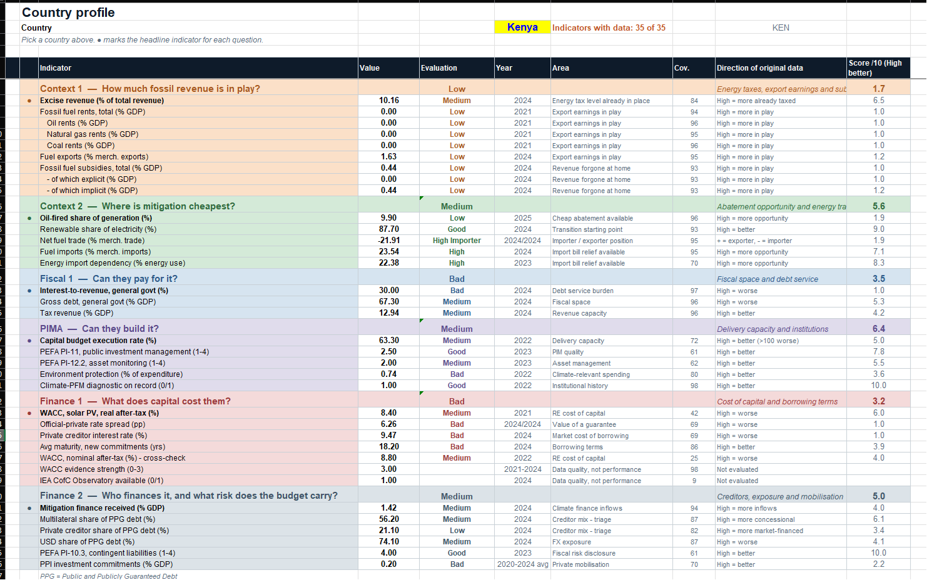
1 · DASHBOARD · PROTOTYPE B: MACRO-FISCAL INDICATORS
The interface in development
A country profile
Kenya shown: 35 of 35 indicators with data
Grouped by question
Fossil revenue, mitigation cost, fiscal space, investment, cost of capital, finance
Scored and sourced
Each indicator rated, scored out of 10, with year and coverage
Coded CPAT and other AI tools · 15
Notes:
AI-built dashboard proof of concept, with a full data audit trail. The tax indicators from the Excise Diagnostic join this base.

Slide 16
1 · DASHBOARD · BRINGING THE PROTOTYPES TOGETHER
Two prototypes become two products
Product 1
Prototype · done
Dashboard
Excise Diagnostic
Macro-fiscal indicators, now with excise and other tax indicators, and the Total Carbon Price
Country tax system: excises, subsidies, electricity pricing
Brought together
Prototype · done
Product 2
Macro-fiscal indicators
Policy issue report
AI dashboard with a full data audit trail
For one issue in one country: the situation, best practice and reform
Coded CPAT and other AI tools · 16
Notes:
Both prototypes exist. Bringing them together gives one dashboard, which now carries tax indicators alongside macro-fiscal ones, and a written policy issue report drawn from the same sourced data.

Slide 17
2 · POLICY ISSUE REPORT
One issue, one country, for example feebates
1
2
3
The situation
Best practice
Reform
Where the country stands on the issue, drawn from the dashboard and diagnostic.
The best policy design, and what other countries did and learned.
The opportunities for reform in that country, and how to get there.
Coded CPAT and other AI tools · 17
Notes:
The dashboard says what is there; the policy issue report says what to do next. Together they give a fast, sourced starting point for policy dialogue.

Slide 18
3 · TOTAL CARBON PRICE UPDATE
Update the Total Carbon Price to link with the GHG accounting metric
A standalone product
Linked to GHG accounting
Also in the dashboard
Delivered on its own, not as part of Coded CPAT.
Consistent with the GHG accounting metric.
Shown alongside the macro-fiscal and tax indicators.
Coded CPAT and other AI tools · 18

Slide 19
4 · CPAT–SISEPUEDE INTEGRATION
Bring coded CPAT into the country pathways tool
With David Groves: CPAT, CPM (formerly SiSePuede), MANAGE and MINDSET combined into one country policy analysis tool, first used in Libya, Egypt and Morocco.
Done · first phase, to July 2026
This year · supervising the CPM team
Scenario assumptions and outputs reconciled
Finish prices, policies and the air pollution translation
Variables mapped and outputs compared
CPAT-LTS investment approach and a policy interface for carbon tax and public investment
Coded CPAT runs in full on the SiSePuede side
Prices and policies partly brought in
Morocco application of the integrated tool
Light touch: about half a day a week, a day a week in January
Coded CPAT and other AI tools · 19
Notes:
From Objective 2 of the work plan. The coded engine itself is built in Part 1; this task is supervision of the CPM team, not new model building.

Slide 20
5 · SINGLE PYTHON PLATFORM
The aim is to make existing models easy to use, not to develop them
What
How
Not
CPAT, MFMod-Python and FTT, as they are today, on one common platform.
A shared set-up and one user guide. FTT made ready to run, with data aligned to CPAT countries.
No further model development, and no full merging of FTT or MFMod into CPAT.
Coded CPAT and other AI tools · 20
Notes:
From Objective 2 of the work plan: a common Python platform for CPAT, MFMod-Python and FTT, with Zoe, in February. The value is access: teams can pick up and run the models we already have.

Slide 21
CONCLUSION
One AI-built base, several products
Two forms of one engine
Kept equal by script
Other AI tools follow
Coded for model work; AI-Excel for the WB–IMF process, GHG accounting and cross-checks.
Generative files keep code, Excel and docs in step, so one model can be kept long-term.
Small tweaks to existing prototypes, CPAT inside SiSePuede, and one Python platform for existing models.
Coded CPAT and other AI tools · 21

Slide 22
NEXT STEPS
What we need to agree
1
Informal chats in the office before 16 October
2
Agree on the WB side, then bring the IMF in
3
Confirm GHG accounting and policy crediting requirements
4
Decide on the dashboard, policy issue report and Total Carbon Price update
5
Choose a country project (to be defined) to apply the engine and tools
Coded CPAT and other AI tools · 22
Notes:
Close by inviting potential issues. The Excel MVP on 16 October is the next checkpoint.

